Slide 1
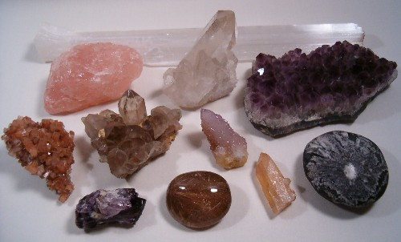
Minerals

Slide 2
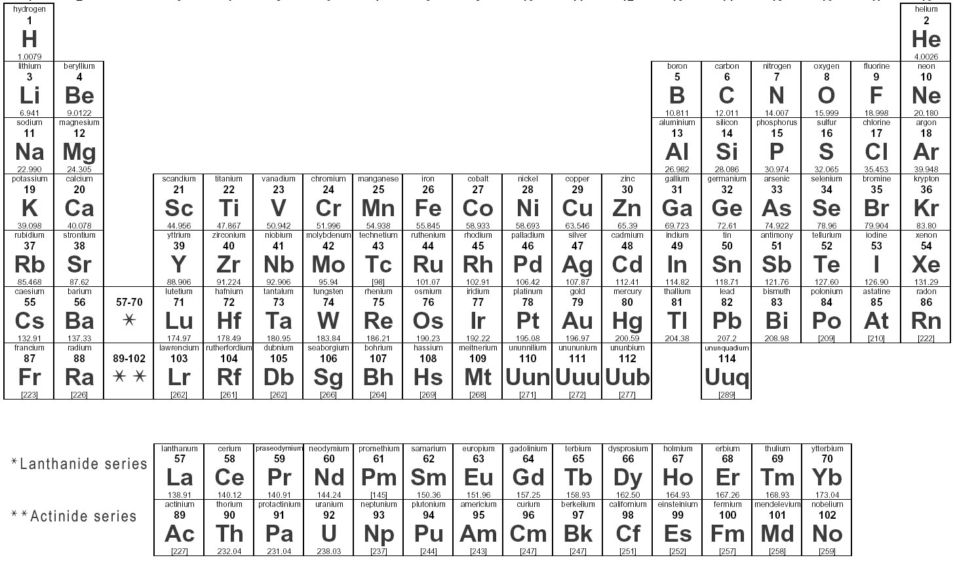
Elements and the Periodic Table
Element: Substance that cannot be broken down into simpler substances by chemical or physical means.
Symbols provide a shorthand to represent elements.
  90 naturally occurring elements.

Slide 3
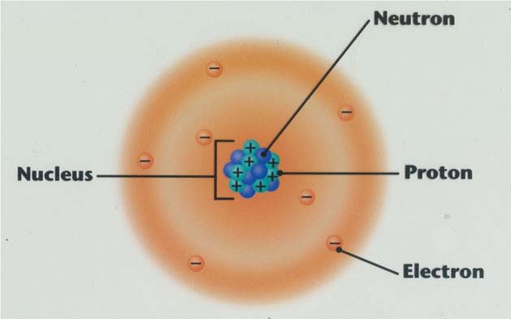
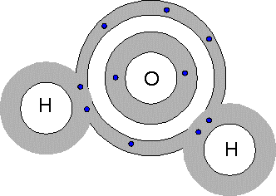
Atoms & Bonding
Atom: Smallest particle of matter that contains the characteristic of an element.
  Bohr’s Model and Cloud Model
Compound: Substance of 2 or more elements that are chemically combined to a stable form.

Slide 4
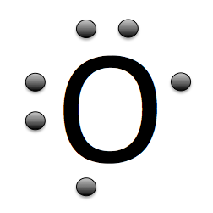
Lewis Dot Diagram
Dots represent electrons in outer shell around the atom.
  Outer shell is also known as energy levels.
Oxygen has 6 electrons in its outer shell.

Slide 5
Parts of the Atom
Proton: Subatomic particle with a positive charge.
  Atomic number: Number of protons an element has.
Neutron: Subatomic particle with a neutral charge.
  Elements with various amounts of neutrons are isotopes.
  Generally most elements try to have the same amount of protons and neutrons.
Electron: Subatomic particle with a negative charge.

Slide 6
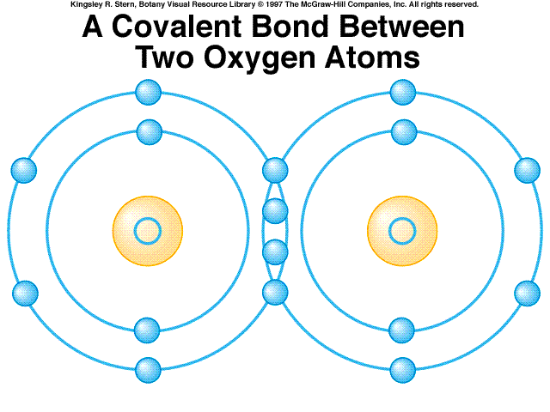
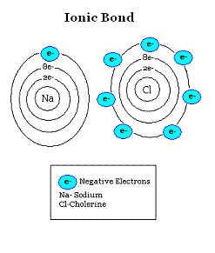
Bonding
Ionic Bond: Form between positive ions and negative ions.
Covalent Bond: Form when atoms share electrons.
Notes:
van der Waals' force: electrostatic interaction of ions between neutral particles. Example is graphite, in between the molecule layers.

Slide 7
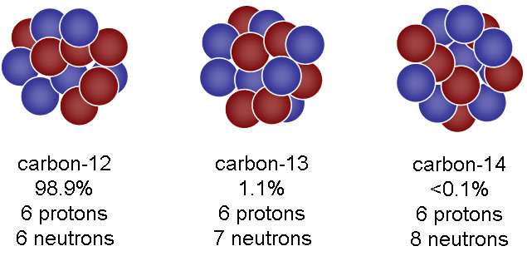
Isotopes
Isotopes: Atoms with same number of protons (atomic number), but varying amount of neutrons.
  Examples: Carbon-12, Carbon-13, Carbon-14
  Atomic mass of the element is based on the weighted average of the stable isotopes of the element found on Earth.
  Isotopes represent stable and unstable forms of an element.
  Unstable forms go through radioactive decay and shed energy and particles.
    The shedding allows them to obtain a stable isotope form.
Notes:
http://www.youtube.com/watch?v=m55kgyApYrY

Slide 8
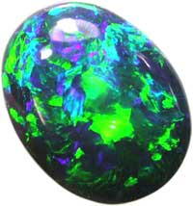
Minerals
A Mineral is:
  Naturally occurring
    Synthetic gems are not considered minerals.
  Solid
    Based on temperatures that occur on Earth.
  Orderly crystalline structure
    Opal is not a mineral because it does not have an orderly internal structure.
  Definite chemical composition
    Salt = NaCl
    Quartz = SiO₂
  Inorganic
    Not formed from plant or animal processes.
      sugar is not a mineral.
Opal

Slide 9
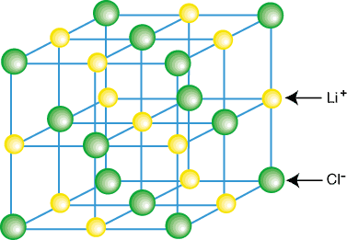
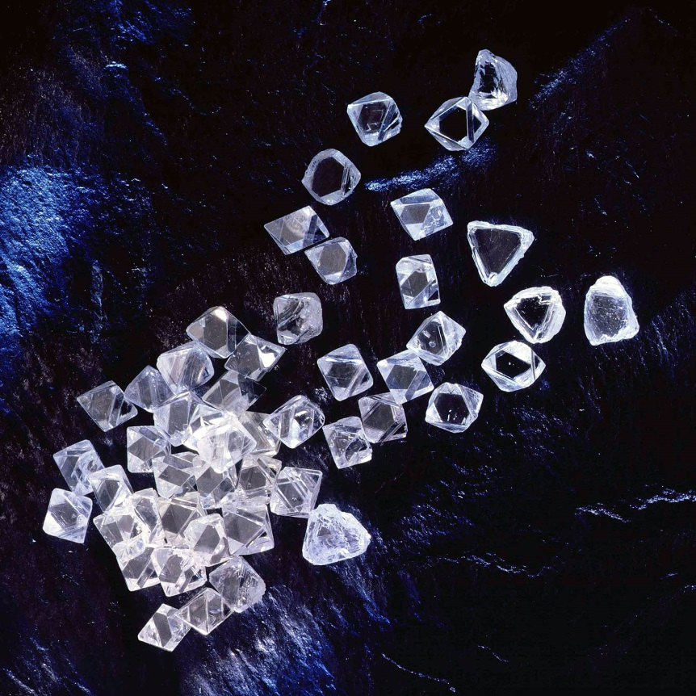
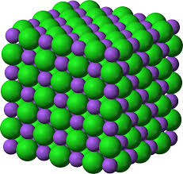
Crystals
Crystal: Is a solid in which the atoms are arranged in a repeating pattern.

Slide 10

Crystal Systems
Cubic – (Ex. Halite - rock salt)
Tetragonal – (Ex. Wulfenite: yellow lead ore)
Hexagonal – (Ex. Corundum: rubies, sapphires)
Orthorhombic – (Ex. Topaz: gem)
Monoclinic – (Ex. Gypsum: drywall)
Triclinic – (Ex. Albite: a type of feldspar)

Slide 11
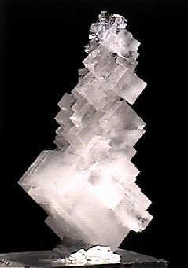
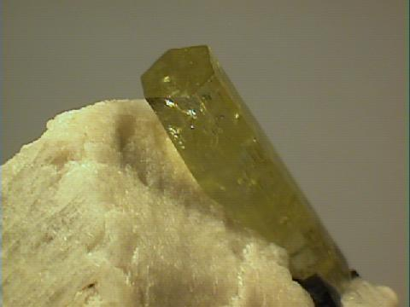
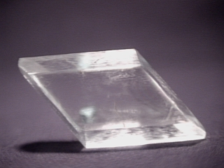

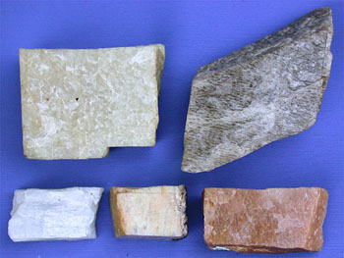
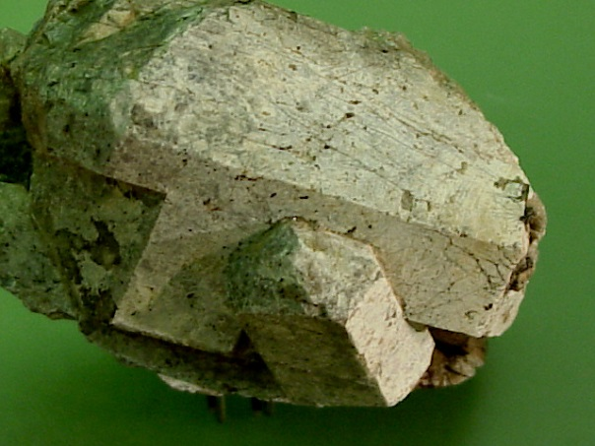
Notes:
Cubic: Halite, Tetragonal:

Slide 12
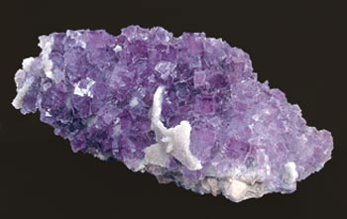
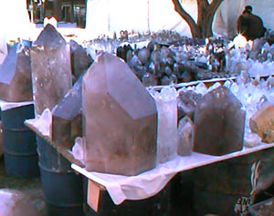
Mineral Formation
Cooling of magma
  Fast cooling produces
  small crystals (grains).
  Slow cooling produces
  large crystals (grains).

Slide 13
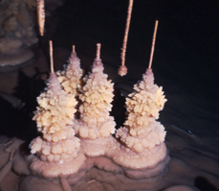
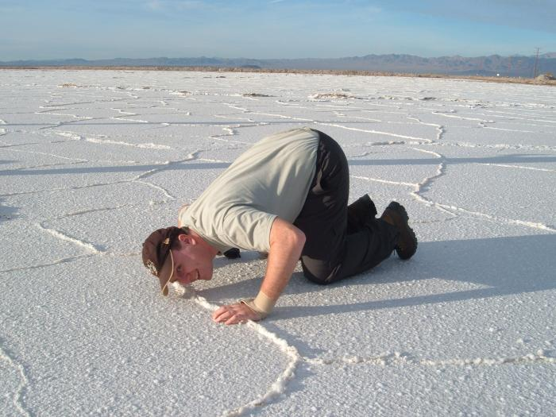
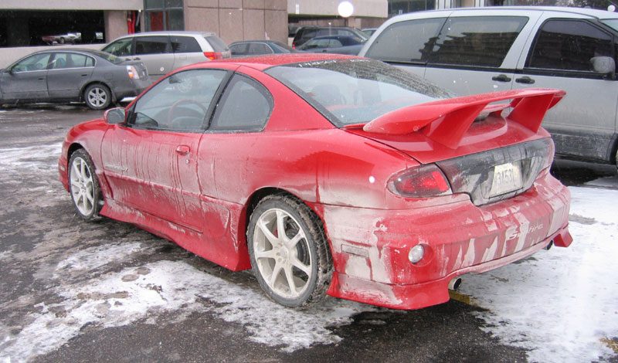
Mineral Formation
  Precipitation: Liquid evaporates leaving behind solids.
    Solids are known as precipitates.
Calcite in caves
Bristol Dry Salt Lake
Road salt left behind from
evaporated salt water

Slide 14
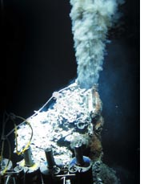
Mineral Formation
Pressure and Temperature
  Changes in temperature and pressure can cause minerals to recrystallize.
  Ex. talc & muscovite
Hydrothermal Solution
  Hot solutions come in contact with existing minerals.
  Ex. some quartz & sulfur

Slide 15
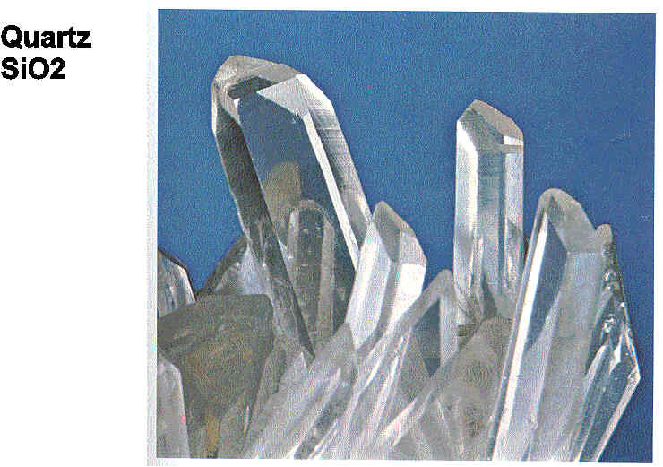
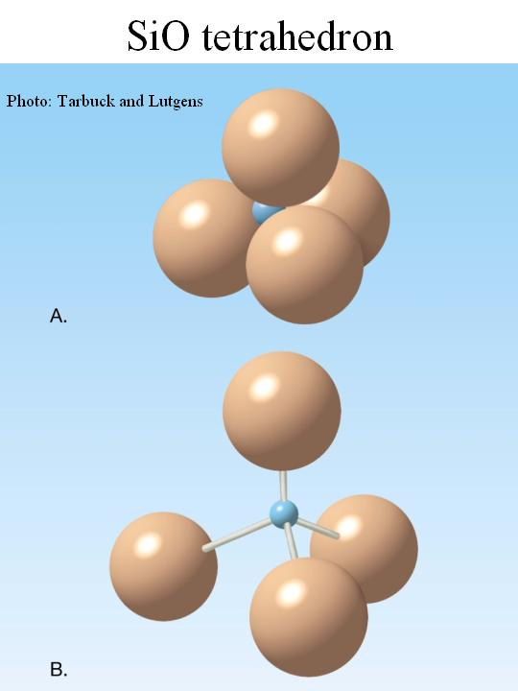
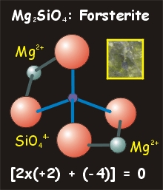
Mineral Composition Groups
A) Silicates: Minerals with silicon-oxygen tetrahedron as their basic structure.
  Ex. Quartz, Feldspar
  Largest mineral group on Earth.

Slide 16
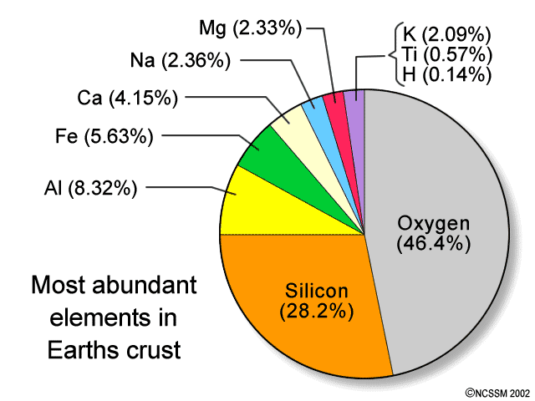
The largest group, the Silicates, have Silicon and Oxygen.

Slide 17
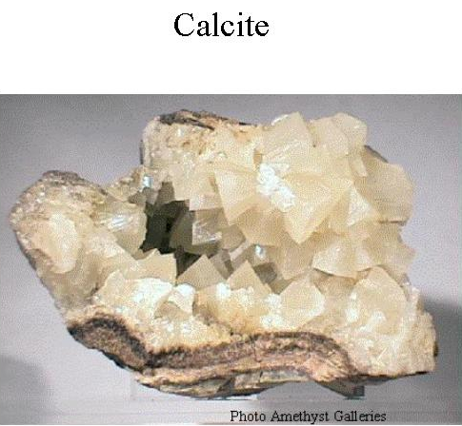
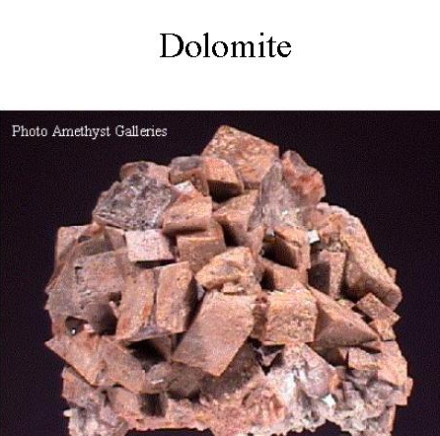
Carbonates
B) Carbonates: Contain carbon, oxygen, and one more metallic element.
  Basic unit is carbonate ion (CO₃)⁻² combined with Ca, Mg, Fe, Cu, etc.
    Fizzes on contact with acid.
  Second largest composition group on Earth.
Ca[CO₃]
CaMg[CO₃]₂

Slide 18
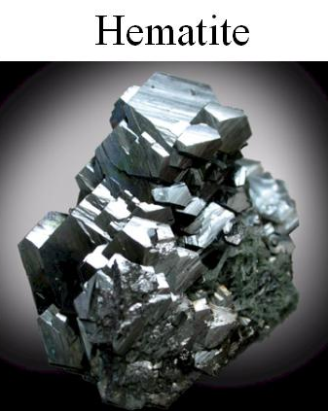
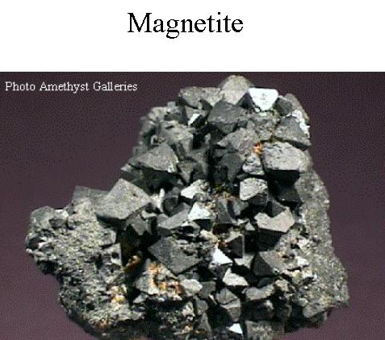
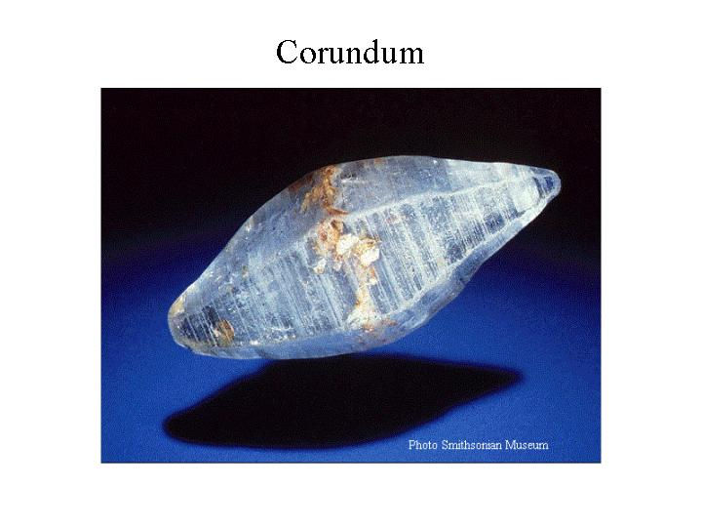
Mineral Composition Groups
C) Oxides: Compounds made of oxygen (O) and a metal or other ion.
  Ex. Hematite, Magnetite, Corundum
Fe₂O₃
FeFe₂O₄
Al₂O₃

Slide 19
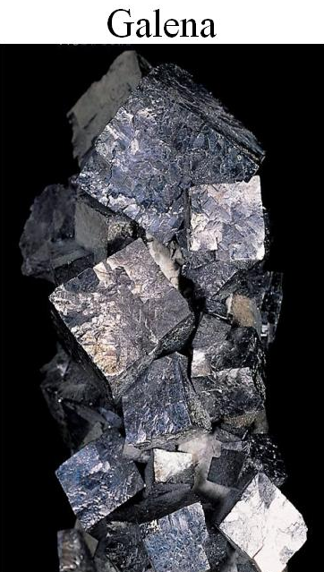
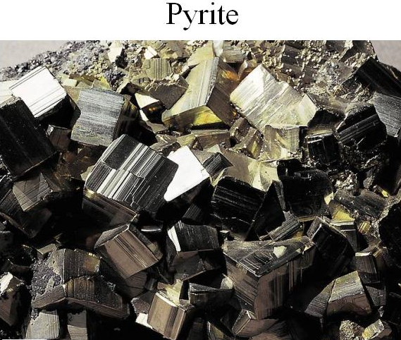
Mineral Composition Groups
D) Sulfides and Sulfates: Combinations of one or more metals with sulfur (S).
PbS
FeS₂

Slide 20
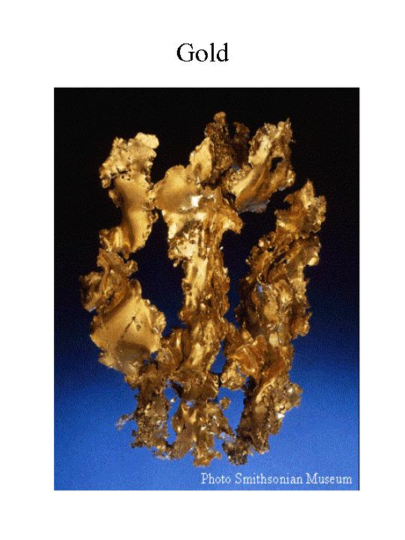
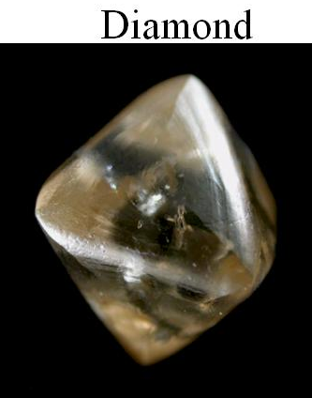
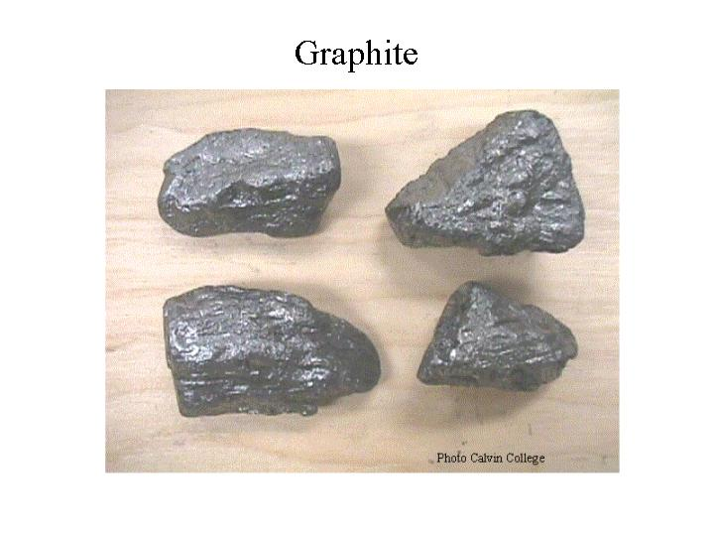
Mineral Composition Groups
E) Native elements: Mineral contains only ONE element.
  About 20 of them.
  Often occur in pure form.
Au
C - carbon
C -carbon

Slide 21
Mineral Formation Video
Properties of Mineral Video

Slide 22






Properties of Minerals
Color
Luster
Streak
Crystal Form
Hardness
Cleavage
Fracture
Density (Specific Gravity)
Special Properties

Slide 23
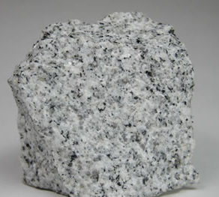
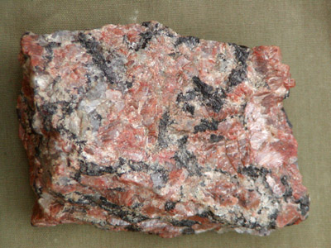
Color
Color: Human perception of the visible light spectrum.
  Poor indicator for mineral.
  Both pictures are granite.

Slide 24
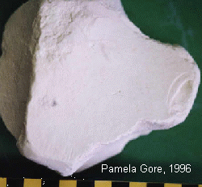
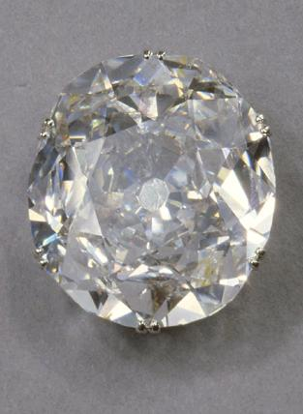
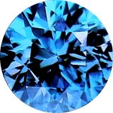
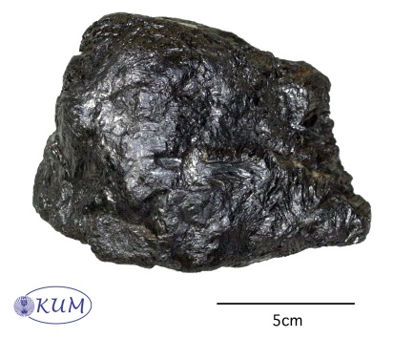

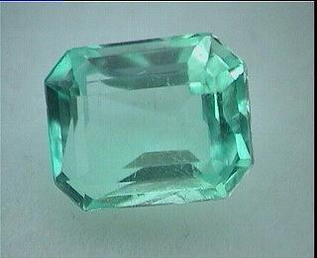

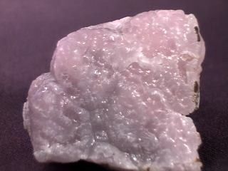
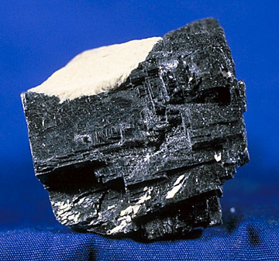
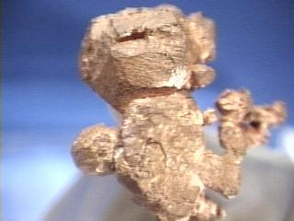
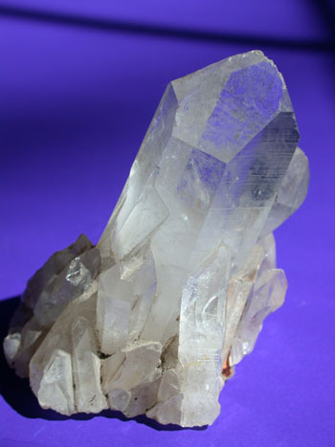
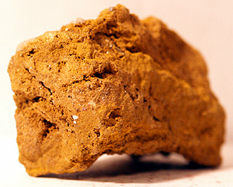
Luster
Luster: Reflection of light off of the mineral.
  Non-Metallic appear dull, pearly, waxy, earthy, vitreous.
  Metallic appear shiny.
Non-Metallic
Metallic
Dull
Adamantine
Shiny
Pearly
Waxy
Earthy
Vitreous

Slide 25
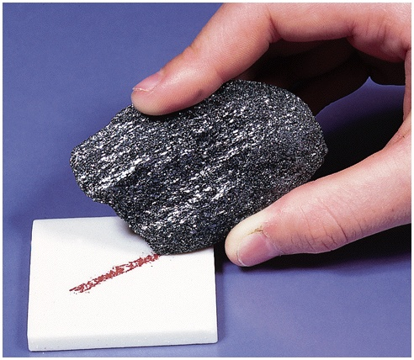

Streak
Streak: Color of a mineral in powder form.
Porcelain Tile

Slide 26



Crystal Form
Crystal form: Visible expression of a mineral’s internal arrangement of atoms.

Slide 27






Hardness
Hardness: Measure of the resistance of a mineral to being scratched.
Talc – Softest (1)
Diamond – Hardest (10)
Notes:
Hardness Scale: Moh’s Scale

Slide 28


Slide 29


Cleavage
Cleavage: Tendency for a mineral to break along flat, even surfaces.
  Breaks along planes of weakness.
Mica has cleavage in 1 direction.

Slide 30


Fracture
Fracture: Uneven breakage of a mineral.
  Conchodial fracturing in Obsidian.
  Random fracturing in Quartz.
Obsidian
Quartz

Slide 31

Density
Density: Amount of mass per volume.
Same size bar of pyrite
(fool’s gold) would be
8 lbs. Density = 5.02_{g/cc}
31 lbs for 1 gold bar
Density = 19.3_{g/cc}

Slide 32






Special Properties
peww
Smell
Taste
Radiation
Florescent
Reacts with acid (HCl)
Yummy…

Slide 33
Gemstones & Diamonds

Slide 34



Birthstones
January – Garnet
  Africa
February – Amethyst
  Mexico, Brazil, USA, Africa
March – Aquamarine
  Brazil, Madagascar

Slide 35



Birthstones
April – Diamond
  Africa
May – Emerald
  Pakistan, Russia, Africa
June – Alexandrite
  Russia

Slide 36



Birthstone
July – Ruby
  Afghanistan, Pakistan
August – Peridot
  USA, China, Australia, Norway
September – Sapphire
  China, Australia, Vietnam, Tanzania

Slide 37



Birthstone
October – Tourmaline (Opal)
  Africa, Afghanistan, Russia
November – Citrine
  Brazil
December – Tanzanite
  Tanzania

Slide 38

Diamond Cuts

Slide 39







Some of the colors of Diamonds

Slide 40

Blood Diamonds
Blood diamonds (conflict diamonds), are mined in war torn African countries by rebels to fund their conflict.
The rebels grossly abuse human rights, often murdering and enslaving the local populations to mine the diamonds.
Notes:
Blood diamonds are also known as conflict diamonds.

Slide 41




Slide 42


Cave of Crystals
Located in Naica, Chihuahua, Mexico.
Giant selenite crystals (Gypsum).
Largest crystal 12m long, 4m wide, weighed 55 tons.
Temperature is 58°C (136°F) at over 90% humidity.
Without proper protection humans can only be in the cave for about 10 minutes.

