Slide 1
Mapping the Earth: Topography

Slide 2
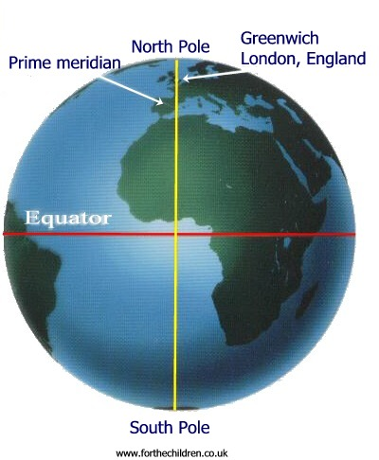
Equator
Equator: Imaginary line that circles the Earth halfway between the North & South Poles.
0°latitude

Slide 3
Latitude
Latitude: Distance measured in degrees north or south of the equator.
We are at 38°North.

Slide 4
Prime Meridian
Prime Meridian: Imaginary line that runs from the North Pole to the South Pole directly through Greenwich, England.
0° longitude

Slide 5
Longitude
Longitude: Distances measured in degrees east or west of the prime meridian.
We are at 77°West.

Slide 6
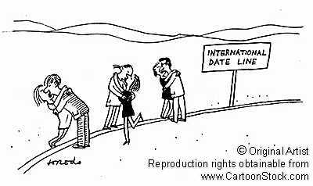
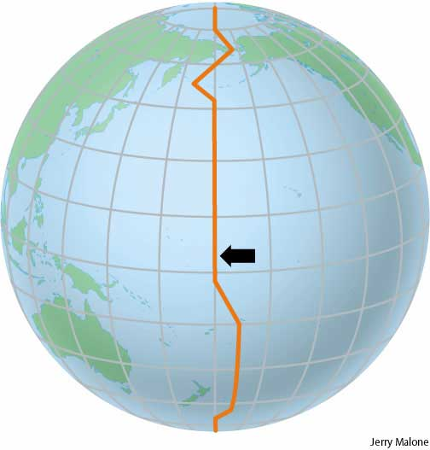
International Date Line
International Date Line: Imaginary line that runs along the 180°longitude.
Transition for calendar days.
Located in the middle of the Pacific Ocean.
Establish by the International Meridian Conference in 1884.
Hawaii is one of the last to bring in the New Year
New Zealand is first to bring in the New Year
1/1/2013 12/31/2014

Slide 7
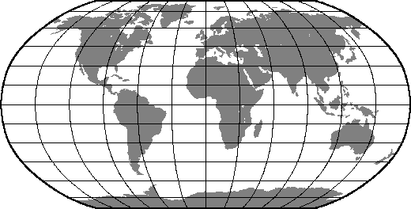
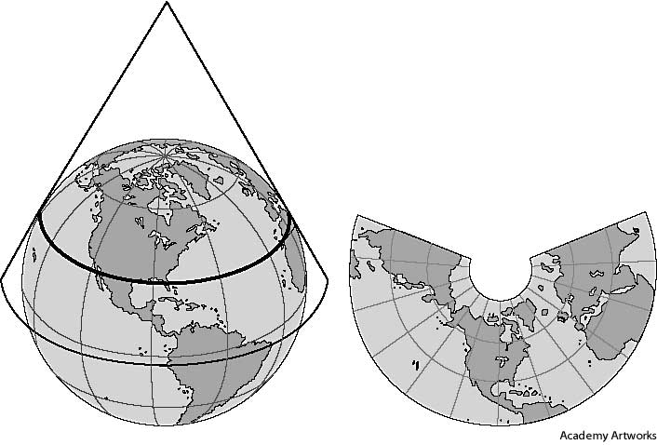
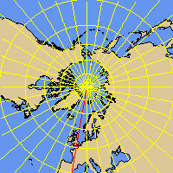
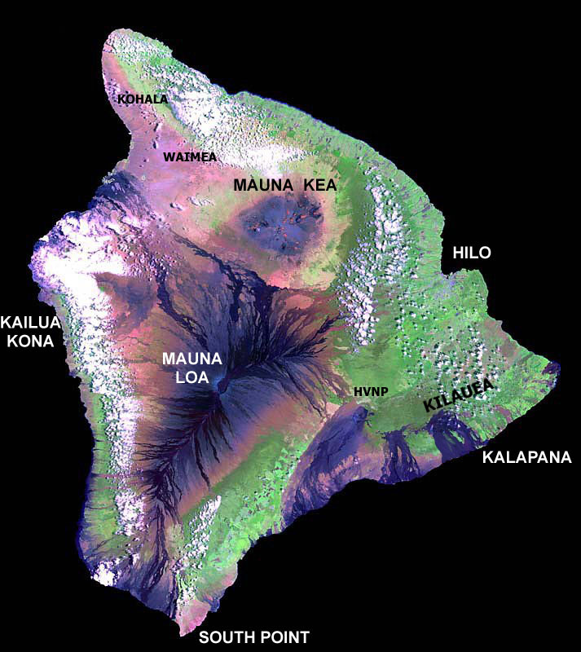
Types of Maps
Mercator Map
Robinson Projection
Conic Projection
Gnomic Projection
Topographic Maps
Satellite Mapping (remote sensing)

Slide 8
Map Overview
Map | Description | Advantages | Disadvantages
Mercator | Parallel lines of latitude and longitude | Shows direction | Distorts size
Robinson | Parallel lines of latitude, curved lines of longitude | Very accurate near the equator | Distorted around the edges and near the poles
Conic | Unfolded cone | Accurate lines of latitude | Distorted lines of longitude
Gnomonic (or Gnomic) | Lines of latitude are circles | Shows shortest distance between two points | Distance and direction distorted

Slide 9
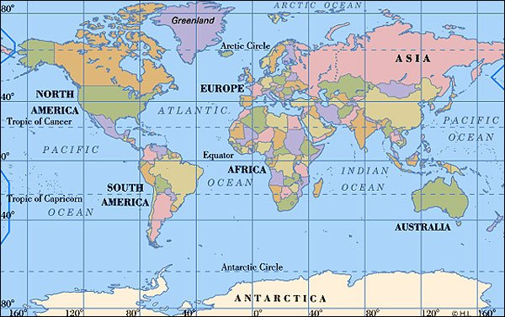
Mercator Projection
Mercator Projection
Parallel lines of latitude and longitude
Distorts size
Shows direction accurately
Popular map

Slide 10
Robinson Projection
2. Robinson Projection
Most commonly used map
Distorted around the edges
Accurate everywhere else
Curved lines of longitude

Slide 11
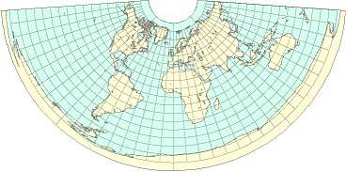
Conic Projection
3. Conic Projection
Very accurate in areas of latitude.
Much distortion of longitude
Most popular for road maps and weather maps.

Slide 12
Gnomonic Projections
4. Gnomonic Projections
The distances and directions are distorted.
Accurately shows the shortest distance between two points
Used by sailors for navigation.

Slide 13
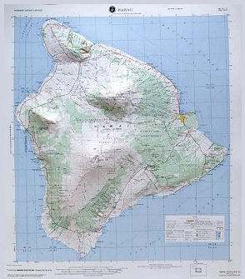
Topographic Maps
Topographic Maps
Show Earth’s 3-D surface on a flat map.
Shows elevation using contour lines.
Very important for geologists, hikers, and campers.

Slide 14
Topographic Maps
Contour Lines
Show elevation (height above sea level).
NEVER cross each other.
All points on the line have the same elevation.
Adjacent lines show a change in elevation.
Every FIFTH line is BOLD and is labeled with elevation.

Slide 15
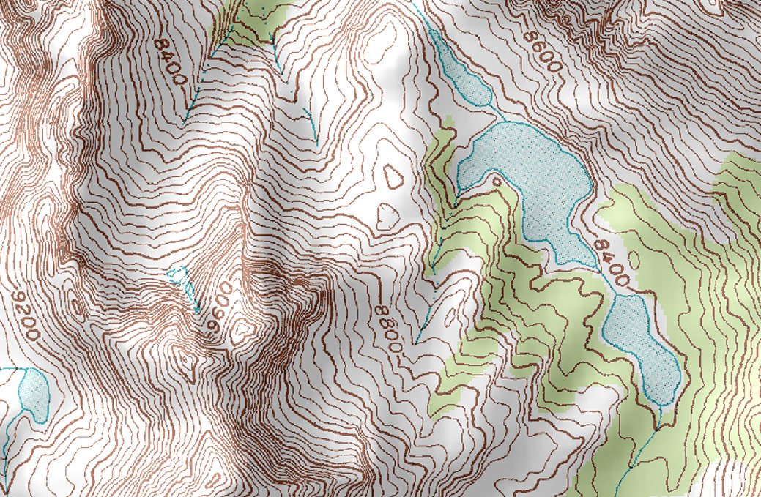

Slide 16
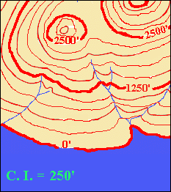
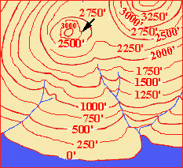
Indicating all contour lines make it look cluttered

Slide 17
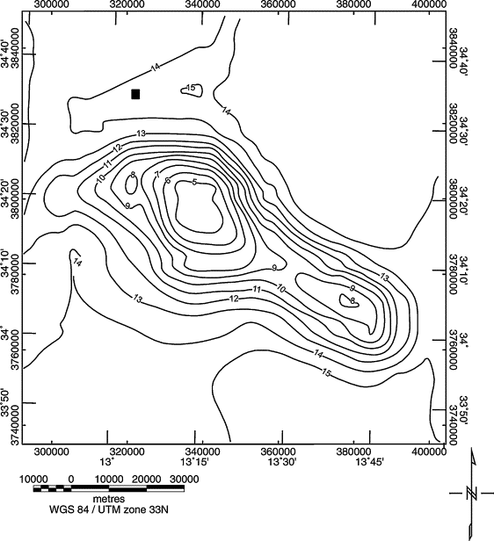

Slide 18
Topographic Maps
Contour Interval (CI): Indicates the difference in elevation between adjacent lines.
The CLOSER the lines are show the steeper the slope
The FURTHER the lines are show the gentler the slope
Circle contour lines show a hill
Hachure marks show a depression
v

Slide 19
Contour interval
Distance between contour lines
500’

Slide 20
Satellite Mapping
Satellite Mapping
Remote Sensing
Making maps much more accurate!
Uses orbiting satellites to collect information.
GPS (Global Positioning Systems)
- GPS uses an instrument that receives signals to compute the latitude and longitude of location.
- Also collects data on speed and direction.

